Slide 1
A Project Report on Black Friday Prediction
Submitted By:
Satu Pole
Intern, Flip Robo Technologies

Slide 2
Contents
Introduction
Problem Statement
Introduction to dataset
Treating Null values and Duplicates and dropping unwanted columns.
Visualizations
Encoding data and treating outliers and skewness
Remarks

Slide 3
Introduction
The Black Friday sales event is one of the most significant shopping days in the retail industry.
In this project the retail company wants to maximize sales and revenue during Black Friday Sale as this shopping event presents a great opportunity for them to boost their sales,
it also poses challenges such as managing inventory, pricing products effectively and predicting customer behaviour to monitor their purchases.

Slide 4
Introduction contd.
This can predict purchase patterns of customers and their preferences and using then companies can make decisions on inventory management and pricing strategies that can lead to increase sales and revenue.
This model will also help in choosing effective marketing strategies and channels and target the right customers with personalized promotions to drive engagement and loyalty.
This will ultimately increase companies sales and help in deliver a better shopping experience to their customers during Black Friday and beyond.

Slide 5
Problem Statement
A retail company “ABC Private Limited” wants to understand the customer purchase behaviour (specifically, purchase amount) against various products of different categories.
They have shared purchase summary of various customers for selected high volume products from last month.
The data set also contains customer demographics (age, gender, marital status, city_type, stay_in_current_city), product details (product_id and product category) and Total purchase_amount from last month.

Slide 6
Introdcution to dataset
The dataset provided to us was in the form of a .csv file. Two datasets were provided to us namely train and test data.
Data analysis has been performed on only train dataset.
The dataset was uploaded to jupyter notebook using pandas library.
The dataset contained 550068 rows and 12 columns.
The dataset included columns such as UserID, ProductID,Gender, Age, Occupation, City_Category,Stay_In_Current_City_Years, Marital_status, Product_Category_1, Product_Category_2, Product_Category_3 and Purchase
Since we has to find the purchase done by a customer during black friday sale hence ‘Purchase’ column was kept as target.

Slide 7
EDA- Treating null values and duplicates and dropping unwanted columns
The dataset was checked if there were any null values present and it occurred that 2 columns had null values present. Upon further analysis these null values were treated by filling them with median values of those particular columns. The columns that had null values present were Product_Category_2 and 3.
the dataset was checked if there are any duplicate values and it was known that there were no duplicates in dataset.
2 columns that are UserID and ProductID were dropped from dataset as these columns contains unique values which are related to unique customers and unique products.

Slide 8
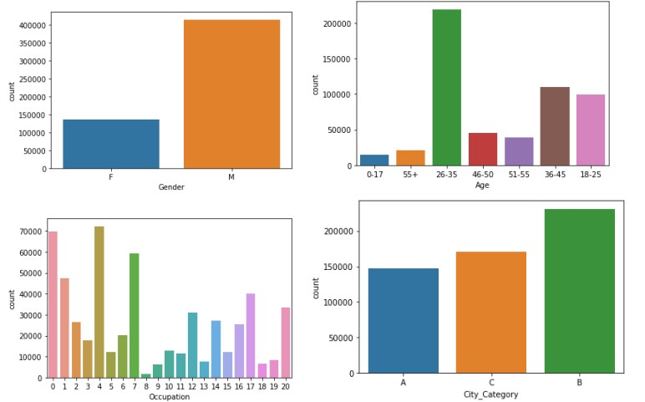
EDA - Visualizations
Observation for plots:
Most number of customers are male while less than half of customers are female.
The persons in age group of 26-35 are more compared to other age groups that participated in black friday sale.
The persons having occupation of value 0,4 and 7 are more compared to other occupations that participated in black friday sale
The customers staying in B city category are more compared to other city groups that participated in black friday sale.

Slide 9
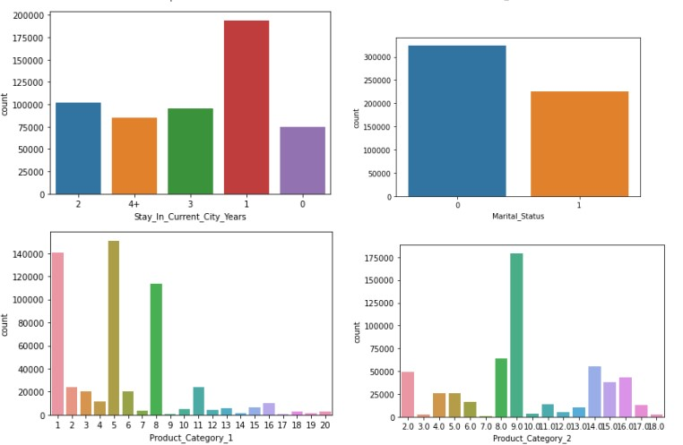
EDA - Visualizations
Observation for plots:
Customers who are staying in current city for past 1 year are more compared to other persons that participated in black friday sale.
Most number of unmarried customers attended black friday sale.
In Product category 1, 1,5 and 8 categorized products were in large numbers compared to other products during black friday sale.
In Product category 2, 2,8 and 014 categorized products were in large numbers compared to other products during black friday sale.

Slide 10
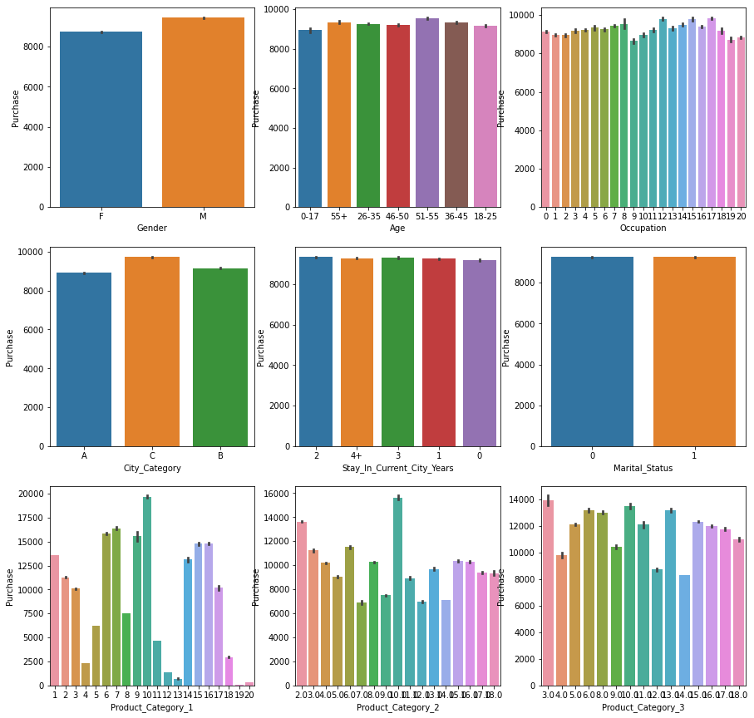
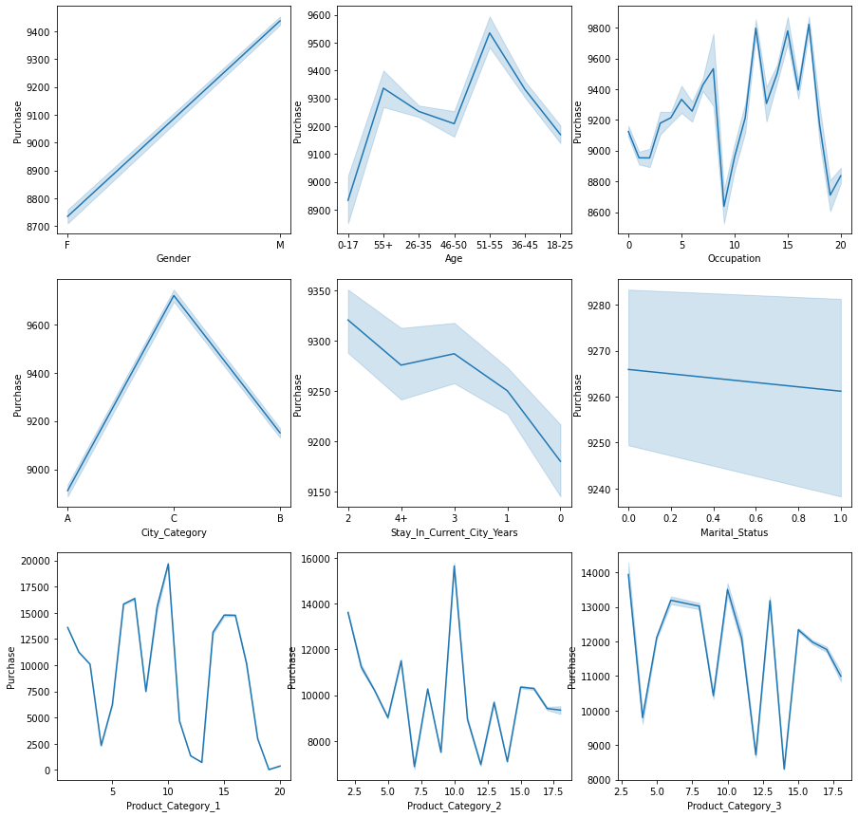
EDA - Visualizations

Slide 11
EDA - Visualizations
Observations for above plots:
The males purchased more products then females during black friday sales.
Purchases for 0-17 age group were slightly lower compared to other age groups.Purchases are highest for 51-55 age group people.
Customers having occupation of 12, 15 and 17 purchased more compared to people from other occupations.
The persons from city category c have purchased more items for black froday then A and B category.
Almost equal number of purchases has been seen for people staying in current city for black friday sale.
Equal number of purchases has been seen in married as well as unmarried people for black friday sale.
In product category 1, products with masked code of 10 have purchased highest by people.
In product category 2, products with masked code of 10 have purchased highest by people compared to other products.
In product category 3, products with masked code of 3 and 10 have purchased highest by people.

Slide 12
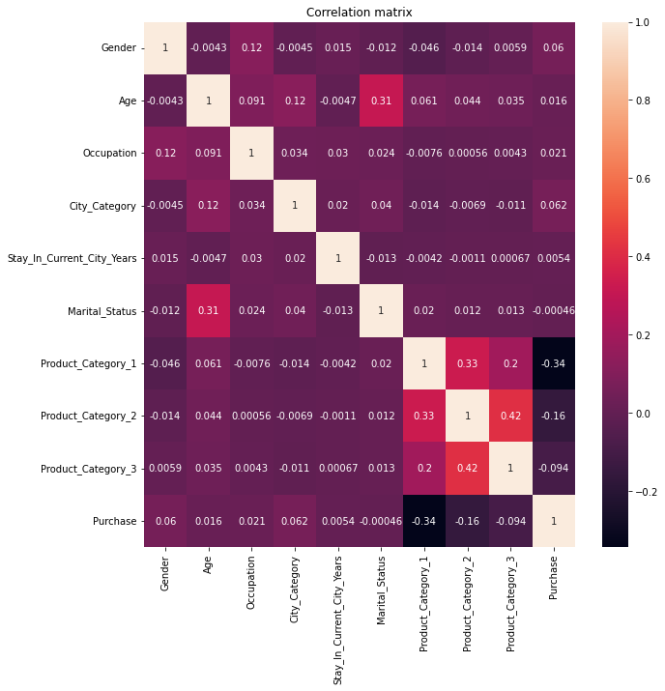
EDA - Visualizations
The figure to the left shows that no columns shows signs of multicollinearity.

Slide 13
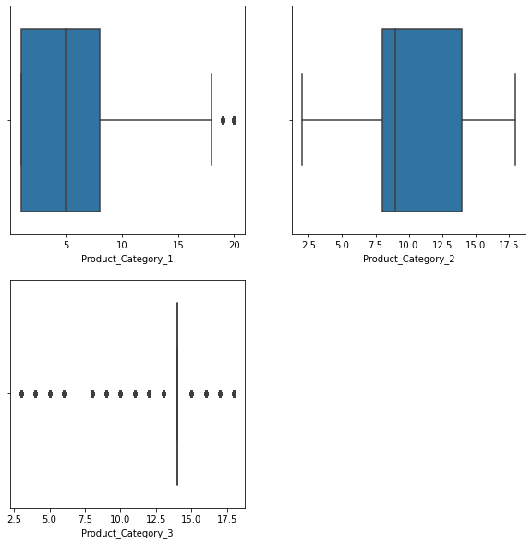
EDA - Visualizations
It can be seen from the plots that product category 1 and 3 columns have outliers present, which were further treated using z score method.

Slide 14
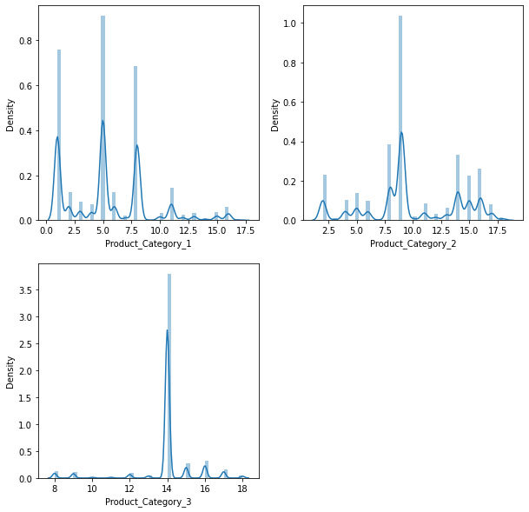
EDA - Visualizations
It can be seen from the plots that product category 1 and 3 columns have skewness present, which were further treated using power transformer method.

Slide 15
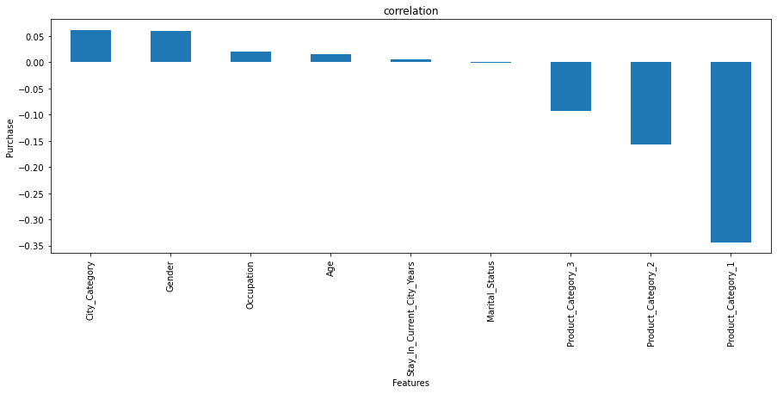
EDA - Visualizations
The above figure shows that column ‘Product_category_1’ is highest negatively related to label while column ‘City_Category’ is highest positively related to label. There were no presence of multicollinearity seen within the dataset.

Slide 16
Remarks
This project does not have any conclusion as such as its machine learning model was not made. Hence how all the features mentioned above will affect the purchases during black Friday sale is not known to us. The observations as per graphical analysis/ visualizations are stated above.

Slide 17
Thank You!!

